Slide 1
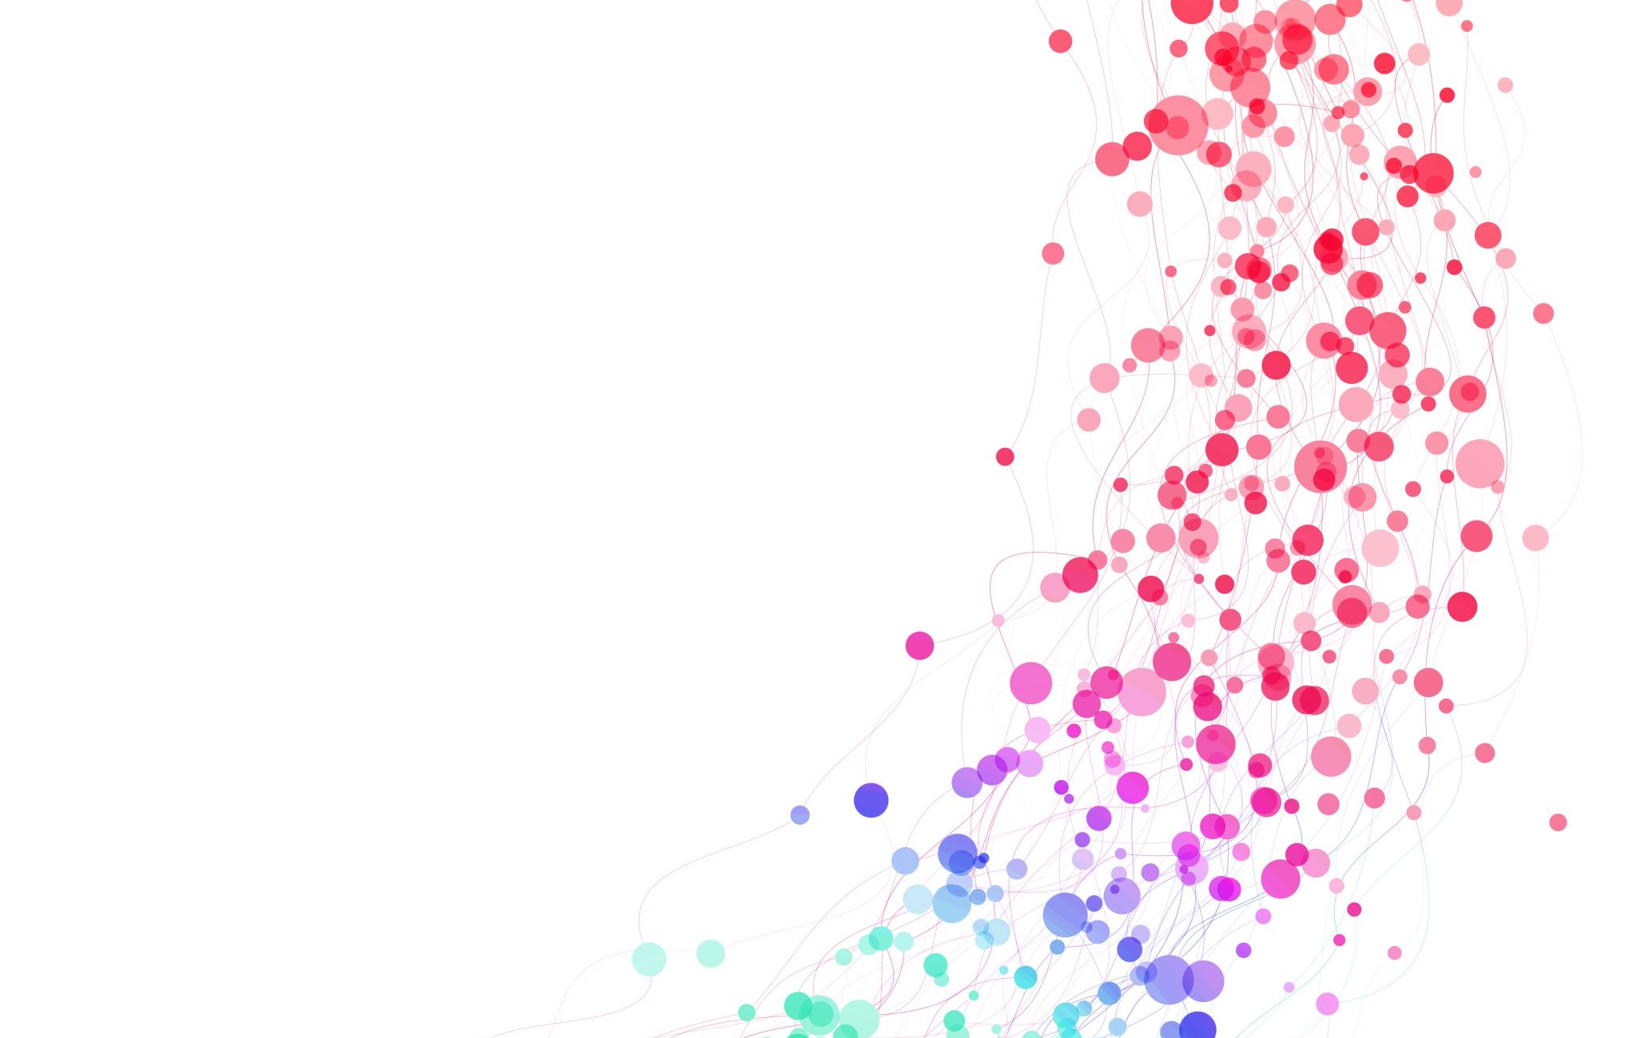

Most Lucrative Industry
CS547 Group 7

Slide 2
Project description
Though many factors influence one’s choice of industry, wages stand out as one of the most important. Is it possible to predict hourly wages for certain occupations in certain industries, and determine which will be the most lucrative in the future? This might prove especially useful to soon-to-be graduates of any discipline, or those looking to carry their skillset over to a different industry.

Slide 3
Dataset
Occupational Employment and Wage Statistics from U.S. Bureau of Labor Statistics
Statistics of State-wise from 2010 to 2021
Features
Total employees
Area title (state)
OCC_TITLE (name of Occupation)
NAICS title (industry type) (Dropped)
Pct-Total (percent of total industry employment which that occupation makes up) (Dropped)
Targets
Mean hourly wage of given industry
Mean annual wage of given industry

Slide 4
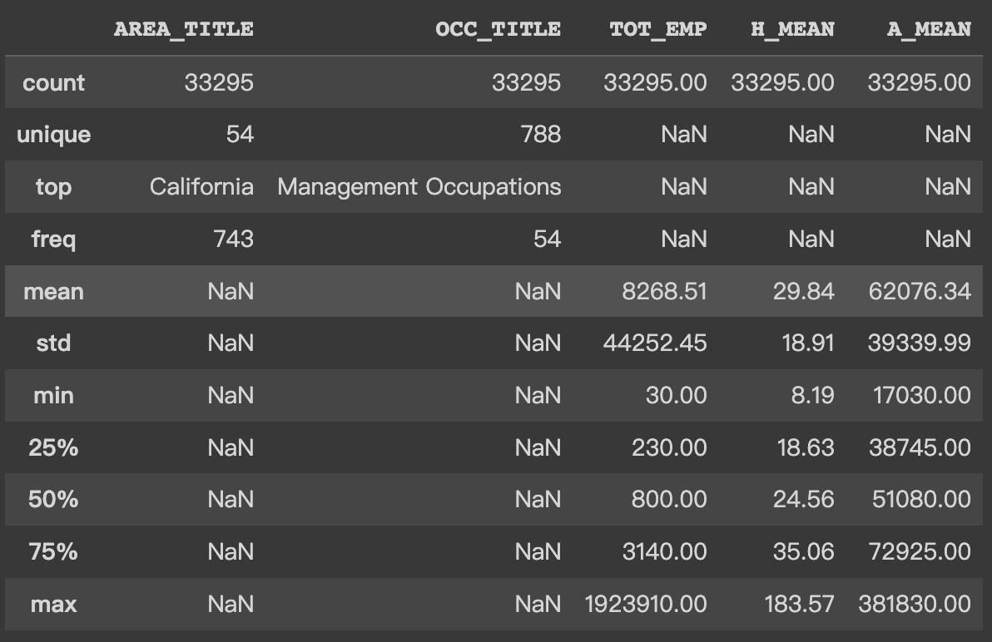
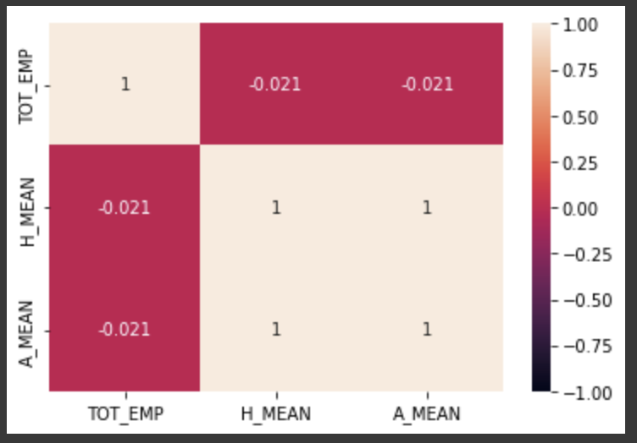
visualization
2021 State Dataframe Information
2021 State Dataframe Heatmap

Slide 5
Preprocessing
Not all of the entries are available according to the state dataset of 2021
“*” indicates that a wage estimate is not available.
“**” indicates that an employment estimate is not available
“#” indicates a wage equal to or greater than $100.00 per hour or $208,000 per year
Replace all the '#' with their lower bound
Remove the “NAICS_TITLE” column since all the entries are the same “cross-industry”. Remove the “PCT_TOTAL” column as it is empty and the meaning of it is simply the “TOT_EMP” divided by the number of “All Occupations” in that state.

Slide 6
PREPROCESSING
On average, “H_MEAN” * 2080 = “A_MEAN”. Use the relationship to fill some of the missing data where either of the two is missing in one row entry.
One-hot encode categorical columns
Scale the data with min-max scaler
Use KNN Imputer to fill the rest of the missing data

Slide 7
Basic linear REGRESSION
Mean squared residual: 15.13804
Mean prediction deviation rate: 54.162%
Error is quite large. Not the best way to predict

Slide 8
Basic Feed Forward Neural Network
Predict only “H_MEAN” as “A_MEAN” is just a scaled version
The network is with 4 layers, using ReLU as activation.
Using Adam Optimizer with Learning Rate of 0.05.
Loss is calculated by Mean Square Error
After 10000 iterations, loss is at 62.64054

Slide 9
PIVOT to Recurrent neural network
The result from Feed Forward is meaningless. What we can get in the end is just a model that predicts hourly wages based on one-hot encoded state and job title.
Its natural to think of how to use past data to predict future, and that sounds a lot like finding patterns using RNN.

Slide 10
Preprocessing
Gather all data between 2010-2021
Perform similar processing steps as before except for the KNN Imputer
Add new column of “Year” representing the year that entry belongs to
Include the column “OCC_CODE” since some title’s name have changed over the years but their code remains the same. Thus, these changed titles should be counted as the same title.

Slide 11
Build model
Position with missing years of Data are dropped
Using LSTM with 5 layers
Batch size of 256 and Learning Rate of 0.002
Input as a vector of floats of size 21 including
54 distinct states represented by 4 floats using embedding
1007 distinct occupations title represented by 16 floats using embedding
Hourly mean wages by itself as 1 float
Hidden layer with dimension 64

Slide 12
Training and Validation
Running with initial setting of 500 epochs
Stops when validation loss has not improved for 30 epochs
Best validation loss: 7.344
Best performance Yet

Slide 13
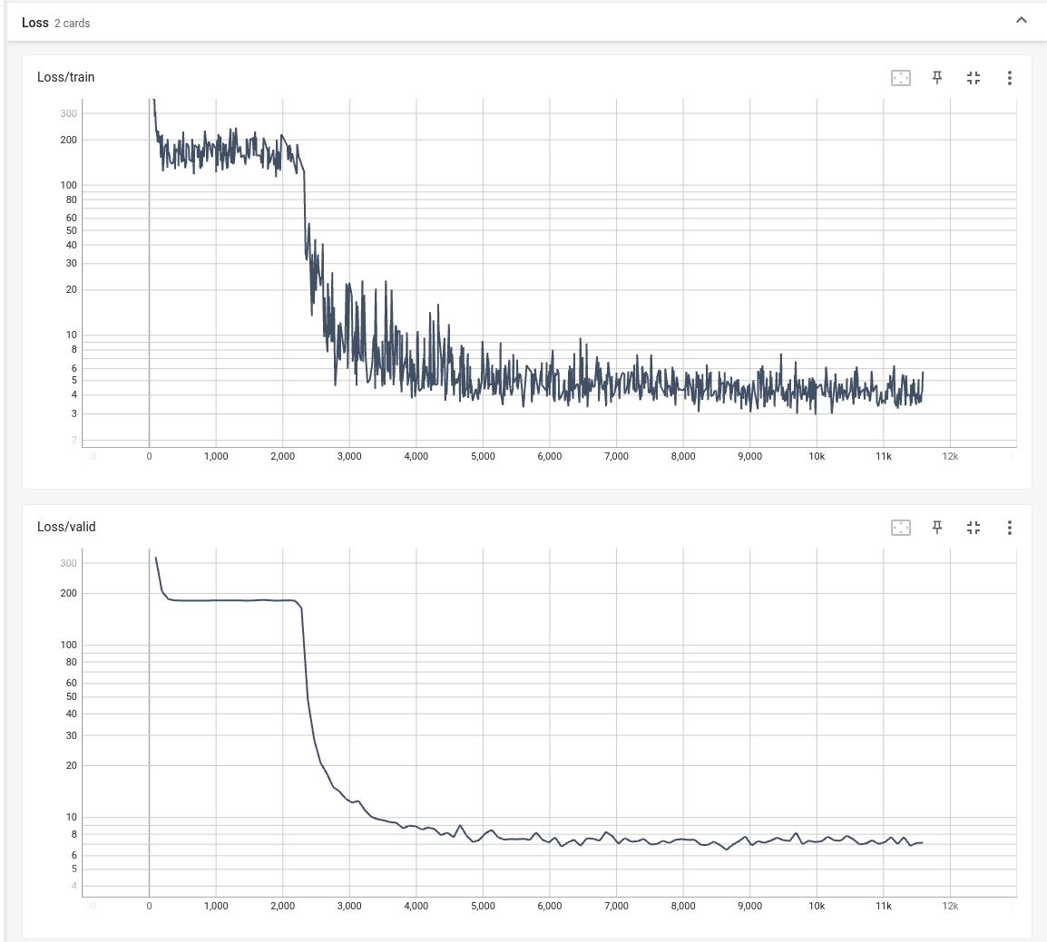
Results Figures

Slide 14
Conclusion
Data retrieving and preprocessing
Trialed Linear Regression, Feed Forward NN, and RNN where RNN gives the best results
The most lucrative industry in 2021 is Orthopedic Surgeons, Except Pediatric in Georgia with a mean hourly wage of $183.57
The predicted most lucrative industry in 2022 will be Chief Executives in New Jersey with a mean hourly wage of $102.23

